Slide 1
Class Agenda
Introduction to Modeler Stream Building
  Source Nodes – How to Read Data into Modeler
  Type Node, Filter Node, Derive Node, Filler Node, Select Node, Sort Node, Field Reorder Node, Table Node
Data Preprocessing
  Data Summarization
    Aggregation Node
  Data Cleaning
  Visual Analysis of Data
  Modeler Example
Data Mining: Concepts and Techniques

Slide 2
Introduction to Modeling in Modeler
Modeler Models are created using streams
Working with SPSS Modeler is a three-step process of working with data.
  • First, you read data into SPSS Modeler,
  • Then, run the data through a series of manipulations,
  • And finally, send the data to a destination.
User’s Guide in help has a lot of info
  Now we will look at the Modeler GUI
Data Mining: Concepts and Techniques

Slide 3
Different Types of Nodes in Modeler
• Sources. Nodes bring data into SPSS Modeler.
• Record Ops. Nodes perform operations on data records, such as selecting, merging, and appending.
• Field Ops. Nodes perform operations on data fields, such as filtering, deriving new fields, and determining the measurement level for given fields.
• Graphs. Nodes graphically display data before and after modeling. Graphs include plots, histograms, web nodes, and evaluation charts.
• Modeling. Nodes use the modeling algorithms available in SPSS Modeler, such as neural nets, decision trees, clustering algorithms, and data sequencing.
• Database Modeling. Nodes use the modeling algorithms available in Microsoft SQL Server, IBM DB2, and Oracle databases. - We don’t have this
• Output. Nodes produce a variety of output for data, charts, and model results that can be viewed in SPSS Modeler.
• Export. Nodes produce a variety of output that can be viewed in external applications, such as IBM® SPSS® Data Collection or Excel.
• SPSS Statistics. Nodes import data from, or export data to, IBM® SPSS® Statistics, as well as running SPSS Statistics procedures.
Source: Modeler help
Data Mining: Concepts and Techniques

Slide 4
Accessing Sources of Data in Modeler
Databases
Text Files
  Variable Length
  Fixed Length
Spreadsheets
Statistics files (SPSS, SAS)
XML Files
User input

Slide 5
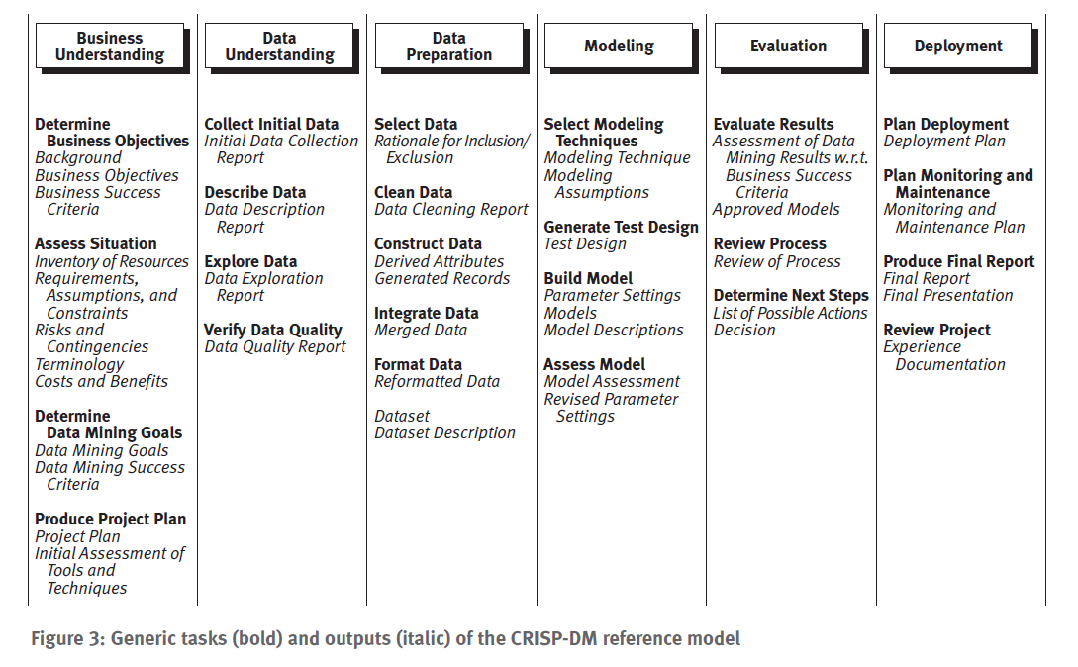
CRISP-DM Data Mining Model
We are discussing this area
Source: CRISP-DM 1.0 Guide from SPSS.com. Also see www.crisp-dm.org

Slide 6
Chapter 2: Getting to Know Your Data
Data Objects and Attribute Types
Basic Statistical Descriptions of Data
Data Visualization
Measuring Data Similarity and Dissimilarity
Summary

Slide 7


Types of Data Sets
Record
  Relational records
  Data matrix, e.g., numerical matrix, crosstabs
  Document data: text documents: term-frequency vector
  Transaction data
Graph and network
  World Wide Web
  Social or information networks
  Molecular Structures
Ordered
  Video data: sequence of images
  Temporal data: time-series
  Sequential Data: transaction sequences
  Genetic sequence data
Spatial, image and multimedia:
  Spatial data: maps
  Image data:
  Video data:

Slide 8
Data Objects
Data sets are made up of data objects.
A data object represents an entity.
Examples:
  sales database: customers, store items, sales
  medical database: patients, treatments
  university database: students, professors, courses
Also called samples , examples, instances, data points, objects, tuples.
Data objects are described by attributes.
Database rows -> data objects; columns ->attributes.

Slide 9
Attributes
Attribute (or dimensions, features, variables): a data field, representing a characteristic or feature of a data object.
  E.g., customer _ID, name, address
Types:
  Nominal
  Binary
  Numeric: quantitative
    Interval-scaled
    Ratio-scaled

Slide 10
Categorical Attribute Types
Nominal: categories, states, or “names of things”
  Hair_color = {auburn, black, blond, brown, grey, red, white}
  marital status, occupation, ID numbers, zip codes
Binary
  Nominal attribute with only 2 states (0 and 1)
  Symmetric binary: both outcomes equally important
    e.g., gender
  Asymmetric binary: outcomes not equally important.
    e.g., medical test (positive vs. negative)
    Convention: assign 1 to most important outcome (e.g., HIV positive)
Ordinal
  Values have a meaningful order (ranking) but magnitude between successive values is not known.
  Size = {small, medium, large}, grades, army rankings

Slide 11
Numeric Attribute Types
Quantity (integer or real-valued)
Interval
    Measured on a scale of equal-sized units
    Values have order
      E.g., temperature in C˚or F˚, calendar dates
    No true zero-point
Ratio
    Inherent zero-point
    We can speak of values as being an order of magnitude larger than the unit of measurement (10 K˚ is twice as high as 5 K˚).
      e.g., temperature in Kelvin, length, counts, monetary quantities

Slide 12
Discrete vs. Continuous Attributes
Discrete Attribute
  Has only a finite or countably infinite set of values
    E.g., zip codes, profession, or the set of words in a collection of documents
  Sometimes, represented as integer variables
  Note: Binary attributes are a special case of discrete attributes
Continuous Attribute
  Has real numbers as attribute values
    E.g., temperature, height, or weight
  Practically, real values can only be measured and represented using a finite number of digits
  Continuous attributes are typically represented as floating-point variables

Slide 13
Data Types in Modeler
The following measurement levels are available:
• Default. Data whose storage type and values are unknown (for example, because they have not yet been read) are displayed as <Default>.
• Continuous. Used to describe numeric values, such as a range of 0–100 or 0.75–1.25. A continuous value can be an integer, real number, or date/time.
• Categorical. Used for string values when an exact number of distinct values is unknown. This is an uninstantiated data type, meaning that all possible information about the storage and usage of the data is not yet known. Once data have been read, the measurement level will be Flag, Nominal, or Typeless, depending on the maximum set size specified in the Stream Properties dialog box.
• Flag. Used for data with two distinct values that indicate the presence or absence of a trait, such as true and false, Yes and No or 0 and 1. The values used may vary, but one must always be designated as the "true" value, and the other as the "false" value. Data may be represented as text, integer, real number, date, time, or timestamp.
• Nominal. Used to describe data with multiple distinct values, each treated as a member of a set, such as small/medium/large. Nominal data can have any storage—numeric, string, or date/time. Note that setting the measurement level to Nominal does not automatically change the values to string storage.
• Ordinal. Used to describe data with multiple distinct values that have an inherent order. For example, salary categories or satisfaction rankings can be typed as ordinal data. The order is defined by the natural sort order of the data elements. For example, 1, 3, 5 is the default sort order for a set of integers, while HIGH, LOW, NORMAL (ascending alphabetically) is the order for a set of strings. The ordinal measurement level enables you to define a set of categorical data as ordinal data for the purposes of visualization, model building, and export to other applications (such as IBM® SPSS® Statistics) that recognize ordinal data as a distinct type. You can use an ordinal field anywhere that a nominal field can be used. Additionally, fields of any storage type (real, integer, string, date, time, and so on) can be defined as ordinal.
• Typeless. Used for data that does not conform to any of the above types, for fields with a single value, or for nominal data where the set has more members than the defined maximum. It is also useful for cases in which the measurement level would otherwise be a set with many members (such as an account number). When you select Typeless for a field, the role is automatically set to None, with Record ID as the only alternative. The default maximum size for sets is 250 unique values. This number can be adjusted or disabled on the Options tab of the Stream Properties dialog box, which can be accessed from the Tools menu.
Source: Modeler help

Slide 14
Introduction to Modeling in Modeler
Simple Example in Demo Folder: ModelingIntro stream
  Will show use of Type Node, Filter Node, Select Node, Sort Node, Field Reorder Node, Table Node
  These are nodes that will be the building blocks for your Modeler Streams
Data Mining: Concepts and Techniques

Slide 15
Chapter 2: Getting to Know Your Data
Data Objects and Attribute Types
Basic Statistical Descriptions of Data
Data Visualization
Measuring Data Similarity and Dissimilarity
Summary

Slide 16
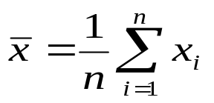

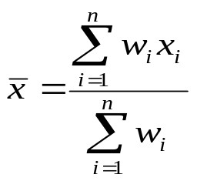
Measuring the Central Tendency
Mean (algebraic measure) (sample vs. population):
  Weighted arithmetic mean:
  Trimmed mean: chopping extreme values
Median: A holistic measure
  Middle value if odd number of values, or average of the middle two values otherwise
Mode
  Value that occurs most frequently in the data
  Unimodal, bimodal, trimodal
  Empirical formula:
Data Mining: Concepts and Techniques

Slide 17



Symmetric vs. Skewed Data
Median, mean and mode of symmetric, positively and negatively skewed data
Data Mining: Concepts and Techniques

Slide 18


Measuring Dispersion - Data Audit Node in Modeler
Aggregate Node and Data Audit Node (will see today in Modeler)- outliers by Standard Deviation or Quartile
  Quartiles: Q₁ (25th percentile), Q₃ (75th percentile)
  Inter-quartile range: IQR = Q₃ – Q₁
  Five number summary: min, Q₁, Mean, Q₃, max
  Outlier: a value higher/lower than 1.5 x IQR
  Skewness, Uniques Values, Valid Values
Variance and standard deviation (sample: s, population: σ)
  Variance: (algebraic, scalable computation)
  Standard deviation s (or σ) is the square root of variance s² ⁽or σ²⁾
Data Mining: Concepts and Techniques

Slide 19
Data Cleaning
Importance
  “Data cleaning is one of the three biggest problems in data warehousing”—Ralph Kimball
  “Data cleaning is the number one problem in data warehousing”—DCI survey
Data cleaning tasks
  Fill in missing values
  Identify outliers and smooth out noisy data
  Correct inconsistent data
  Resolve redundancy caused by data integration

Slide 20
Missing Data
Data is not always available
  E.g., many tuples have no recorded value for several attributes, such as customer income in sales data
Missing data may be due to
  equipment malfunction
  inconsistent with other recorded data and thus deleted
  data not entered due to misunderstanding
  certain data may not be considered important at the time of entry
  not register history or changes of the data
Missing data may need to be inferred.

Slide 21
How to Handle Missing Data?
Ignore the tuple: usually done when class label is missing (assuming the tasks in classification—not effective when the percentage of missing values per attribute varies considerably.
Fill in the missing value manually: tedious + infeasible?
Data Audit Node - Fill in it automatically with
  a global constant : e.g., “unknown”, a new class?!
  the attribute mean
  the attribute mean for all samples belonging to the same class: smarter
  the most probable value: inference-based such as Bayesian formula or decision tree

Slide 22
Modeler Data Summarization Examples
Telco_dataaudit stream in Demo folder
  Will show the use of the data audit node
  Will also show filler and derive nodes
ADP_basic_demo stream in Demo folder
  Shows Modeler’s auto data prep node
    This node can be dangerous! – It does a lot of things (some of which are questionable) with very little explanation
Data Mining: Concepts and Techniques

Slide 23
Chapter 2: Getting to Know Your Data
Data Objects and Attribute Types
Basic Statistical Descriptions of Data
Data Visualization
Measuring Data Similarity and Dissimilarity
Summary

Slide 24

Boxplot Analysis
Five-number summary of a distribution:
  Minimum, Q1, M, Q3, Maximum
Boxplot
  Data is represented with a box
  The ends of the box are at the first and third quartiles, i.e., the height of the box is IRQ
  The median is marked by a line within the box
  Whiskers: two lines outside the box extend to Minimum and Maximum
Data Mining: Concepts and Techniques

Slide 25

Histogram Analysis
Graph displays of basic statistical class descriptions
  Frequency histograms
    A univariate graphical method
    Consists of a set of rectangles that reflect the counts or frequencies of the classes present in the given data
Data Mining: Concepts and Techniques

Slide 26
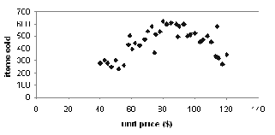
Scatter plot
Provides a first look at bivariate data to see clusters of points, outliers, etc
Each pair of values is treated as a pair of coordinates and plotted as points in the plane
Data Mining: Concepts and Techniques

Slide 27


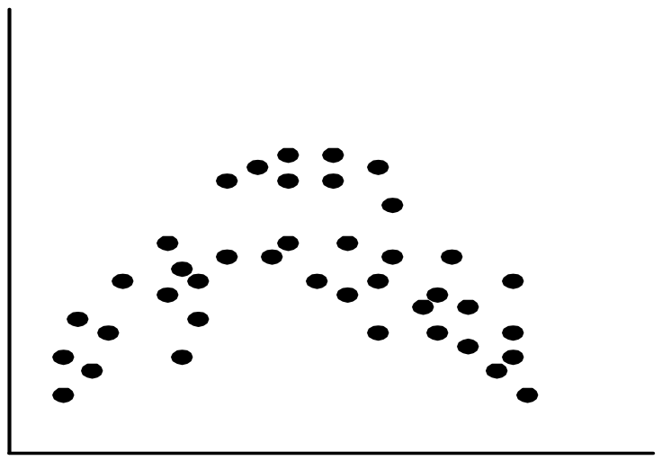
Positively and Negatively Correlated Data
Data Mining: Concepts and Techniques

Slide 28


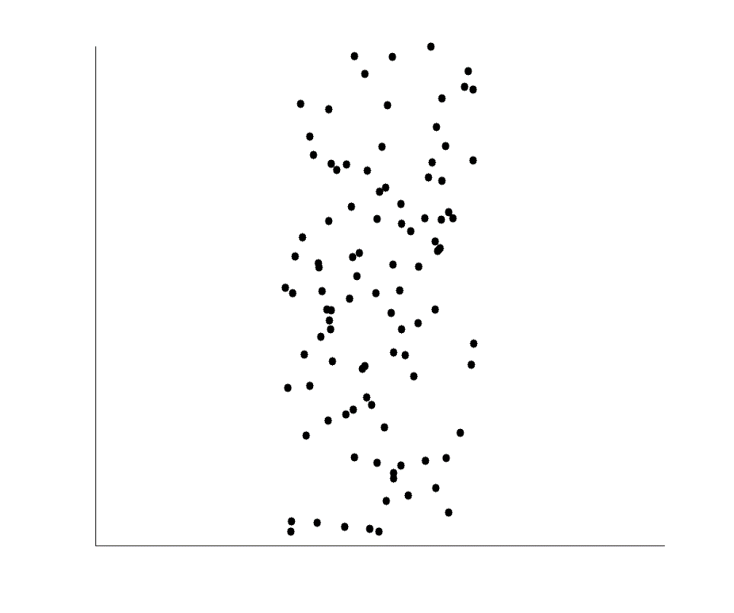
Not Correlated Data
Data Mining: Concepts and Techniques

Slide 29
Modeler Demo of Visualization
Graphing Nodes
  Histogram/Distribution Node
  Plot Node
  Collection Node
  Multiplot Node
  Graphboard
    This node has many different graphing options
Data Mining: Concepts and Techniques

Slide 30
References
D. P. Ballou and G. K. Tayi. Enhancing data quality in data warehouse environments. Communications of ACM, 42:73-78, 1999
T. Dasu and T. Johnson. Exploratory Data Mining and Data Cleaning. John Wiley & Sons, 2003
T. Dasu, T. Johnson, S. Muthukrishnan, V. Shkapenyuk. Mining Database Structure; Or, How to Build a Data Quality Browser. SIGMOD’02.
H.V. Jagadish et al., Special Issue on Data Reduction Techniques. Bulletin of the Technical Committee on Data Engineering, 20(4), December 1997
D. Pyle. Data Preparation for Data Mining. Morgan Kaufmann, 1999
E. Rahm and H. H. Do. Data Cleaning: Problems and Current Approaches. IEEE Bulletin of the Technical Committee on Data Engineering. Vol.23, No.4
V. Raman and J. Hellerstein. Potters Wheel: An Interactive Framework for Data Cleaning and Transformation, VLDB’2001
T. Redman. Data Quality: Management and Technology. Bantam Books, 1992
Y. Wand and R. Wang. Anchoring data quality dimensions ontological foundations. Communications of ACM, 39:86-95, 1996
R. Wang, V. Storey, and C. Firth. A framework for analysis of data quality research. IEEE Trans. Knowledge and Data Engineering, 7:623-640, 1995
Data Mining: Concepts and Techniques

